Slide 1
Evaluation of Treatment Efficacy Among Hard-Drug Using HIV Patients Receiving Highly Active Antiretroviral Therapy (HAART)
Marshall Roll
3/2/25

Slide 2
Research Questions
Data: 463 HIV-positive individuals receiving highly active antiretroviral therapy (HAART) with complete outcome and baseline covariate data, sourced from Multicenter AIDS Cohort Study
Difference in effect of hard drug use on lab-based outcomes (log10 viral load & CD4+ T-cell count) and survey-based outcomes (SF-36 Physical & Mental Component Scores)
Bayesian & frequentist models for the 2-year change in each of the four outcomes with primary explanatory variable as hard drug use
Control for standard covariates (baseline age, BMI, education, smoking status, and race) & baseline value of outcome
Effect of HAART adherence
Descriptive statistics to assess relationship between hard drug use and adherence
Bayesian & frequentist models for each of the four outcomes, adjusting for adherence

Slide 4
Adherence
Lower Adherence to HAART
2-year HAART Adherence | Hard Drug Use N = 36 | No Hard Drug Use N = 427
≥95% Adherence | 35 (97%) | 382 (89%)
<95 % Adherence | 1 (2.8%) | 45 (11%)
?
?
Hard Drug Use
Worse Health Outcomes
Fisher’s Exact Test: p = 0.11

Slide 5
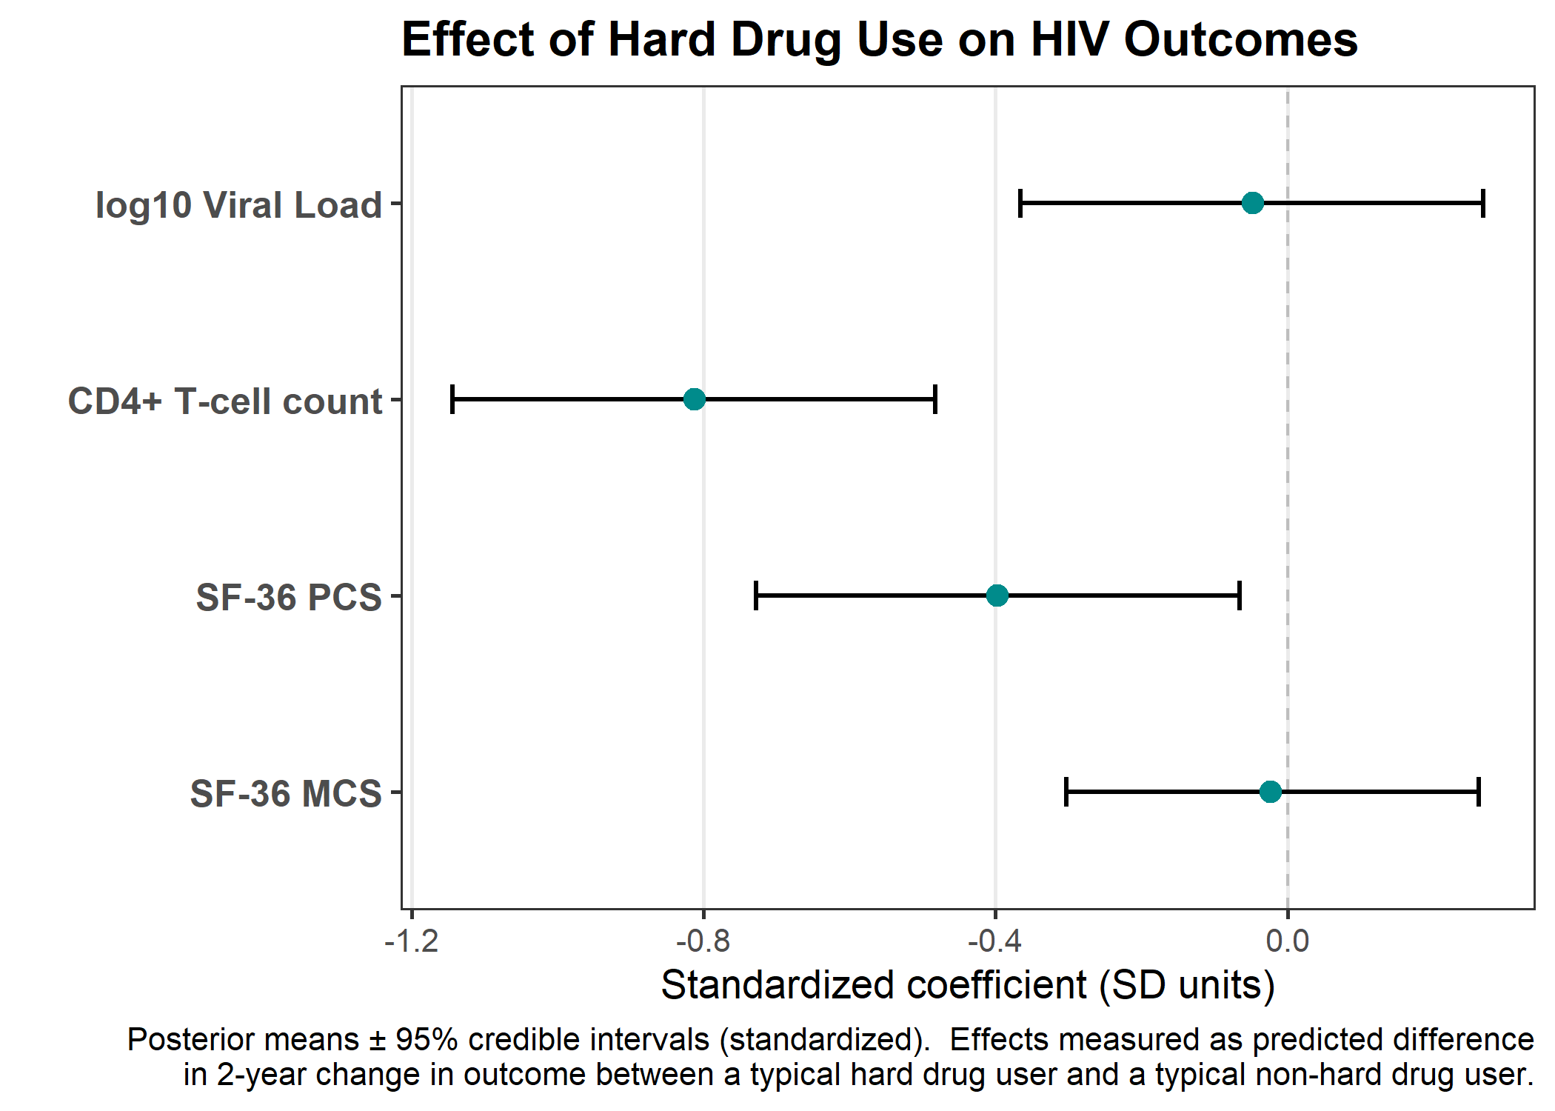

Slide 6
Conclusions
Statistically significant effect of hard drug use on 2-year changes in CD4+ T-cell count and SF-36 PCS
Insignificant effect on log10 viral load and SF-36 MCS
Adherence does not meaningfully change hard drug use estimates across all outcomes
Beneficial effects of HAART therapy may be mitigated in hard drug users
Limitations
Missingness assumptions
Generalizability

